Slide 1
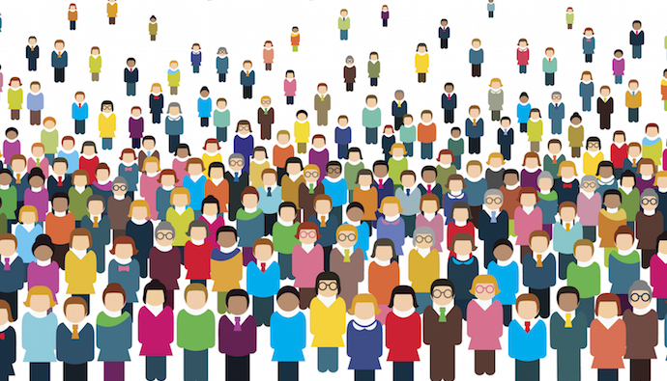
Understanding Global Dynamics: Population, Health Systems, Gender Equality
Teammates:
Jaynica Nunna 11697960
Vitesh Chalicheemala 11689328
Mounika Vankayalapati 11714417
Supriya Ravilla 11644767

Slide 2
Introduction
Our project focuses on understanding crucial aspects of global dynamics, including population trends, healthcare systems, and gender equality.
By analyzing and visualizing data related to these domains, we aim to uncover insights that contribute to informed decision-making and drive positive societal change.
Through this endeavor, we seek to provide valuable insights into the complex interplay of factors shaping our world today.

Slide 3
Data Abstraction
Dataset:
We utilized three datasets sourced from reputable sources such as the Kaggle and one from given ten choice of datasets.
These datasets encompassed a wide range of attributes, including population demographics, healthcare infrastructure, innovation indices, and gender inequality metrics.
Number of Records:
The combined datasets comprised thousands of records, with each record representing a specific country or region.
The exact number varied across datasets but totaled well over a thousand records in aggregate.
Data Transformation:
Before analysis and visualization, we performed extensive data preprocessing to clean and harmonize the datasets. This involved tasks such as handling missing values, standardizing units of measurement, and ensuring data consistency across different sources.

Slide 4
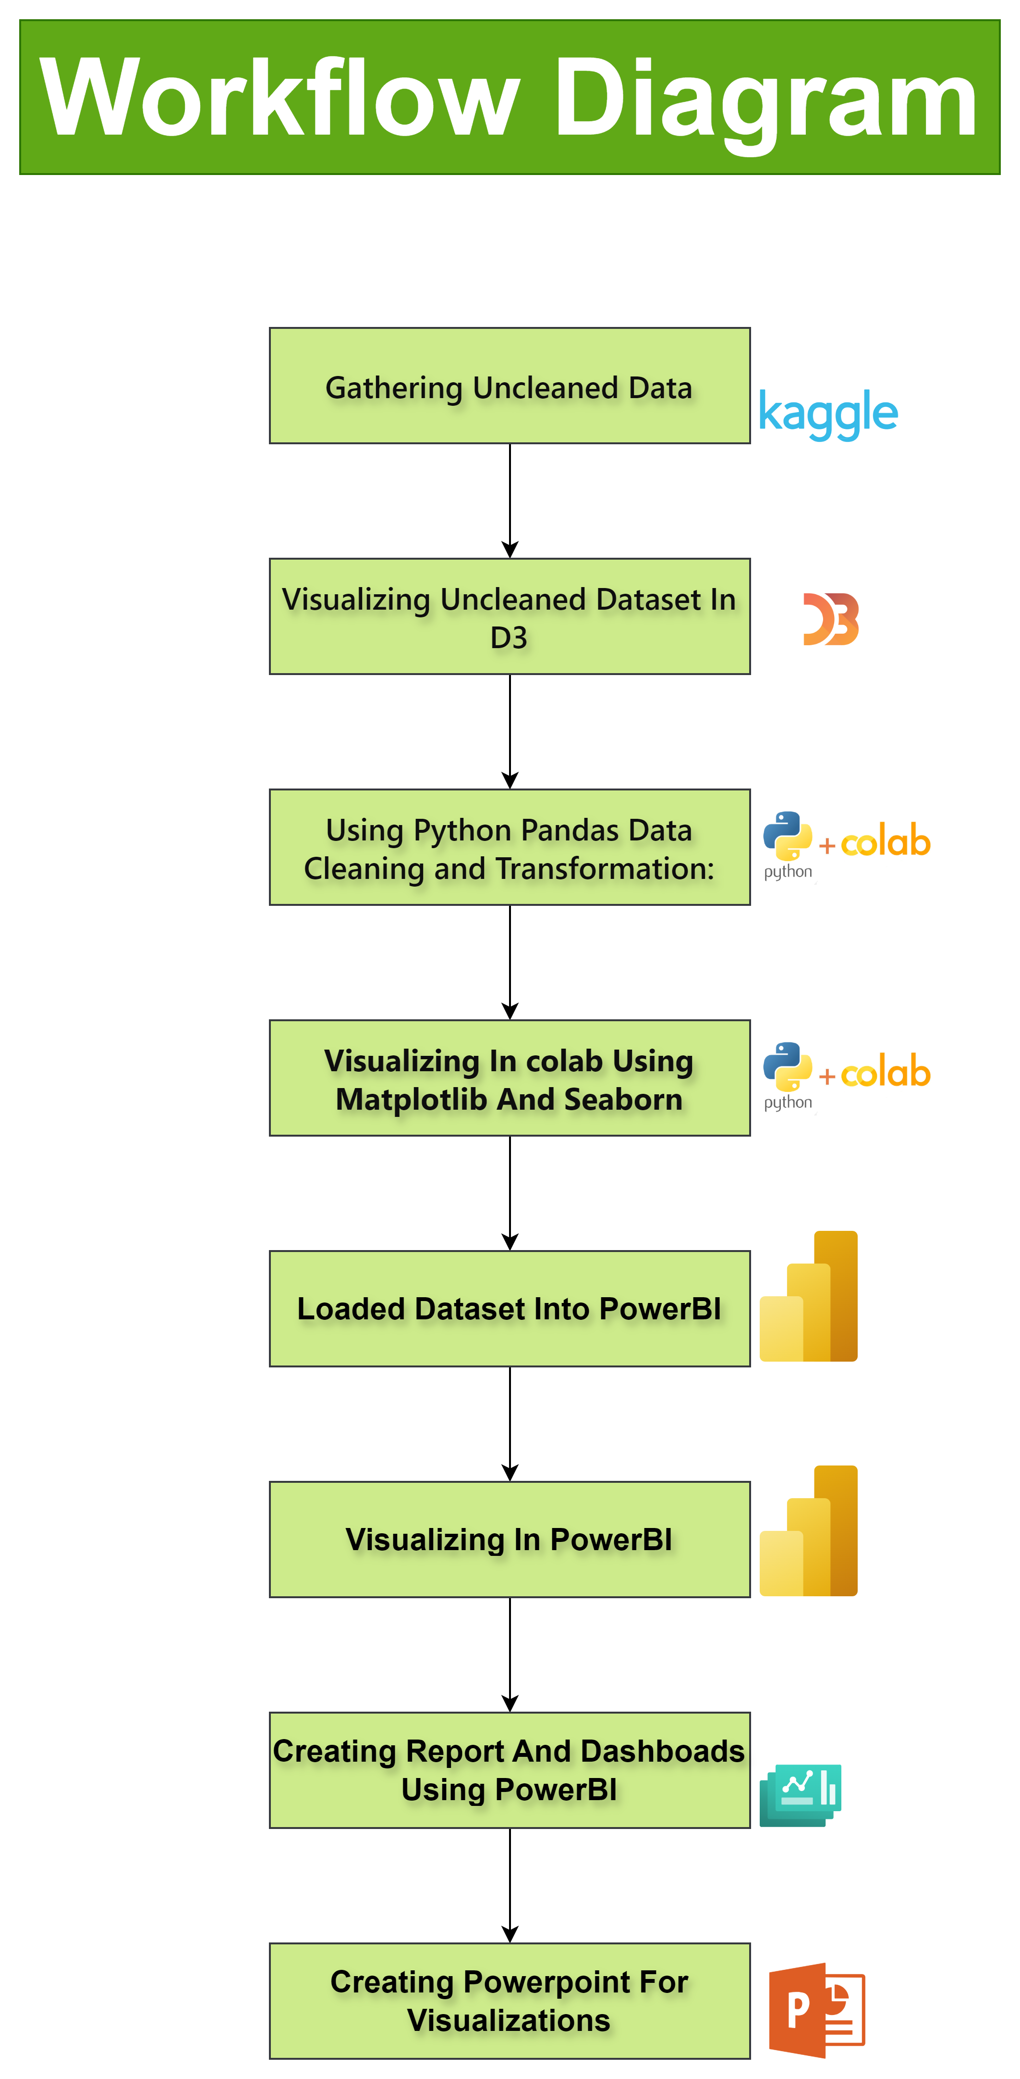

Slide 5
Above Workflow Explaination
Data Collection:
Getting relevant datasets from Kaggle, a popular platform for data science datasets.
Initial Visualization:
Utilizing D3.js to visualize the uncleaned dataset, providing an initial overview of the data's structure and potential insights.
Data Cleaning:
Using Python programming language and libraries like Pandas and NumPy to clean the dataset, handling missing values, outliers, and inconsistencies.
Refined Visualization:
Using Python's data visualization libraries such as Matplotlib or Seaborn to create more refined visualizations based on the cleaned dataset, focusing on specific variables of interest.
Dashboard Creation:
Utilizing Microsoft Power BI to design interactive dashboards and reports, incorporating the refined visualizations to provide a comprehensive view of the analyzed data.
Report Generation:
Creating detailed reports summarizing the analysis findings, insights, and conclusions drawn from the visualizations and data analysis process.

Slide 6
Task Abstraction
Task:
Target:
To analyze and visualize key aspects of global dynamics, including population demographics, healthcare systems, and gender equality metrics.
Actions:
Data Collection: Gather relevant datasets from Kaggle, focusing on population demographics, healthcare infrastructure, innovation indices, and gender inequality metrics.
Initial Visualization: Utilize D3.js to create preliminary visualizations of the uncleaned dataset, providing an initial overview of its structure and potential insights.
Data Cleaning: Employ Python programming language and libraries like Pandas and NumPy to clean the dataset, handling missing values, outliers, and inconsistencies.
Refined Visualization: Use Python's data visualization libraries such as Matplotlib or Seaborn to generate more polished visualizations based on the cleaned dataset, highlighting specific variables of interest.
Dashboard Creation: Utilize Microsoft Power BI to design interactive dashboards and reports, integrating the refined visualizations to offer a comprehensive view of the analyzed data.
Report Generation: Create detailed reports summarizing analysis findings, insights, and conclusions drawn from the visualizations and data analysis process, facilitating informed decision-making.

Slide 7
Implementation using Tools:
D3.js:
Description: D3.js (Data-Driven Documents) was utilized for the initial visualization of the uncleaned dataset. It provided a platform for creating dynamic and interactive charts and graphs directly within web browsers.
Usage: Through D3.js, we generated interactive visualizations such as bar charts, scatter plots, and heatmaps to explore the structure and patterns within the raw dataset.
Python:
Description: Python, along with libraries like Pandas, NumPy, Matplotlib, and Seaborn, played a crucial role in data preprocessing, analysis, and visualization.
Usage: Pandas and NumPy were employed for data cleaning tasks, including handling missing values, outliers, and inconsistencies. Matplotlib and Seaborn were used to create refined visualizations based on the cleaned dataset, showcasing insights through various types of charts and plots.
Microsoft Power BI:
Description: Microsoft Power BI served as a comprehensive platform for designing interactive dashboards and reports, integrating visualizations to provide a comprehensive view of the analyzed data.
Usage: Power BI enabled us to create interactive visualizations, including bar charts, line graphs, and maps, and seamlessly integrate them into interactive dashboards. Additionally, Power BI's data modeling capabilities allowed for the creation of relationships between different datasets, enhancing the depth of analysis in the final reports.

Slide 8
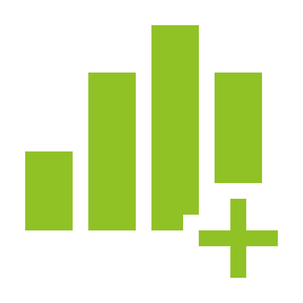
Results for Analysis

Slide 9
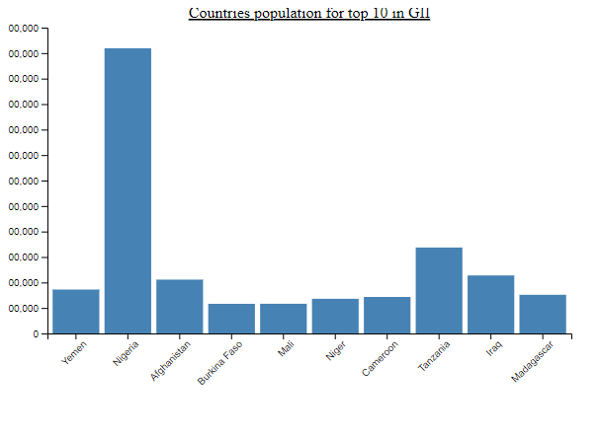
Using D3
This visualization represents the population of the top ten countries in 2023.
Each bar's height corresponds to the population size of a specific country.
By comparing the heights of the bars, we can see which countries have larger populations relative to others
And data used here is not preprocessd or cleaned.

Slide 10
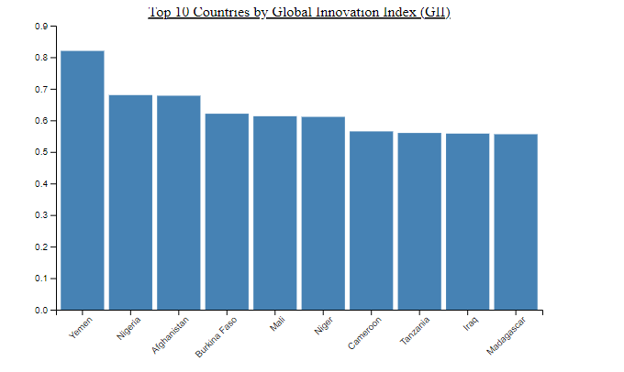
Using D3
we're visualizing the Global Innovation Index (GII) of the top ten countries.
Each bar represents a country, and the height of the bar indicates its GII score.
This visualization allows us to compare the innovation levels of different countries, with taller bars indicating higher innovation scores.
And data used here is not preprocessd or cleaned.

Slide 11
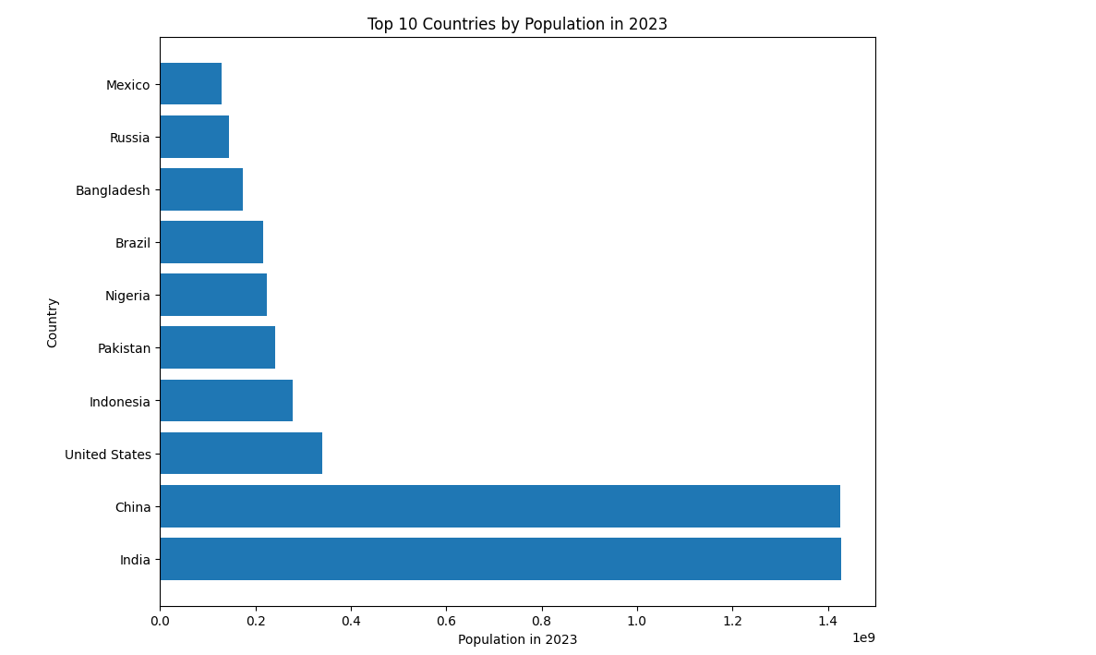
Data Pre-processing using python
After preprocessing datasets, we stored all three datasets in to csv., using pandas.
Later using Visualisation libraries we created below visuals.

Slide 12
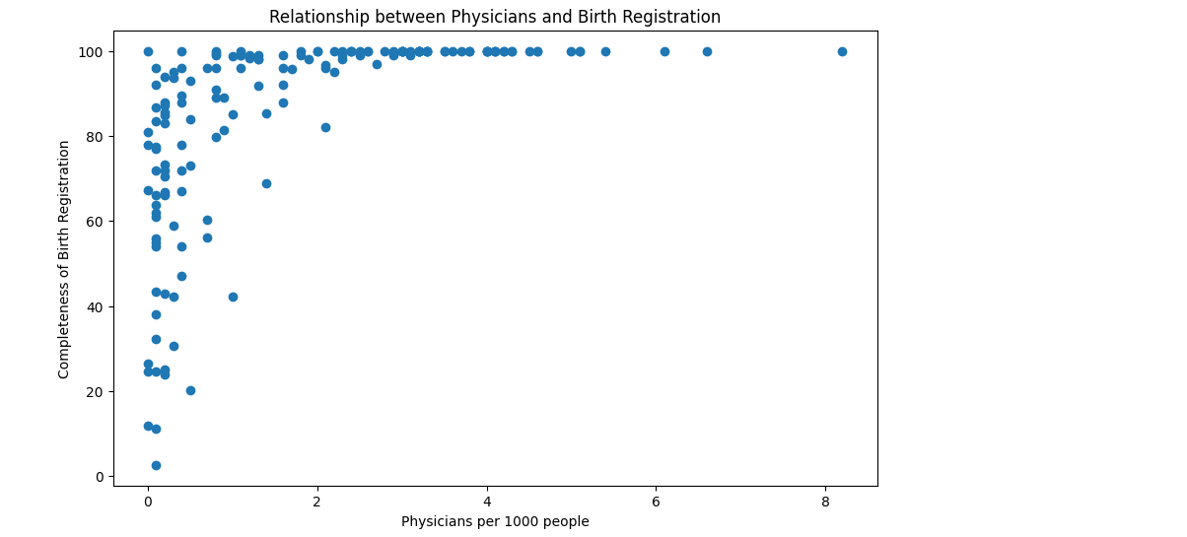
Relationship between pysicians and birth registration
In terms of healthcare systems, each point in this scatter plot represents a nation's journey towards wellness.
As we see the axis of physicians per 1000 people, we uncover a tale of access to healthcare.
Meanwhile, the completeness of birth registration whispers a story of governance and care, painting a picture of a nation's commitment to its citizens' well-being.

Slide 13
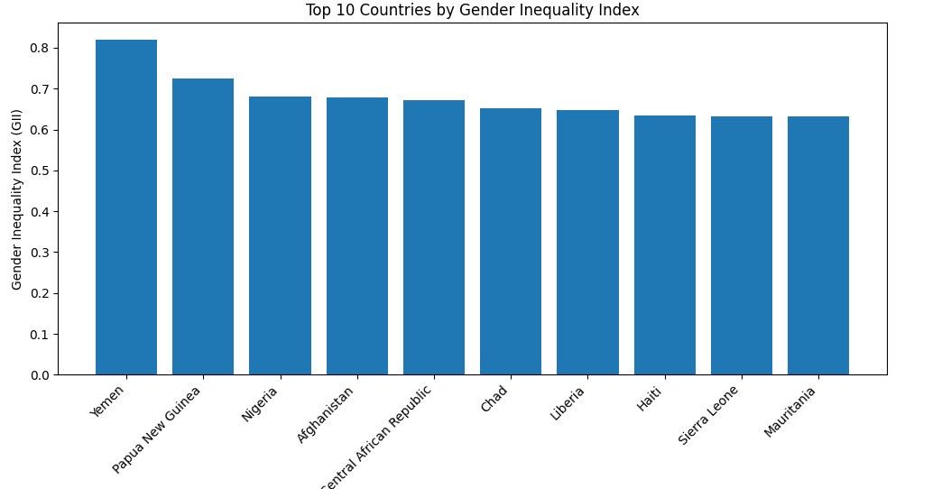
On top we have shown same visual using D3 , that’s before data preprocessing.

Slide 14
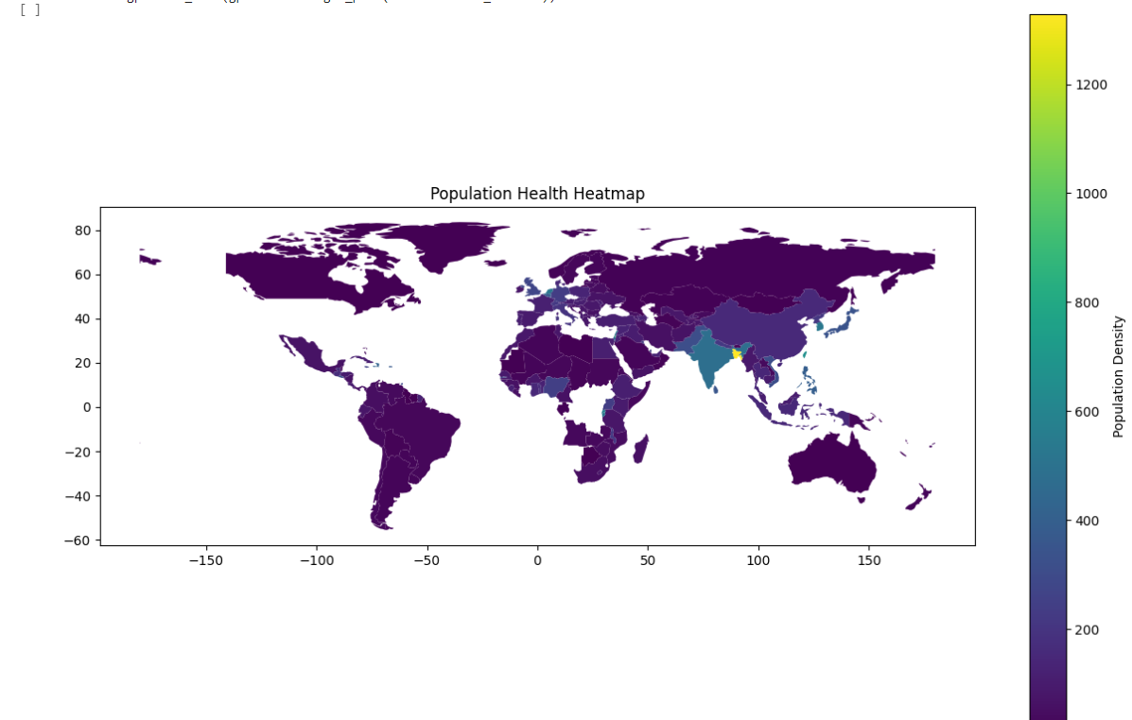
Population health heatmap
Across the world, this map paints a picture of people's presence.
Each color showcases the density of population, offering a straightforward glimpse into where people gather, from bustling cities to quieter regions.

Slide 15
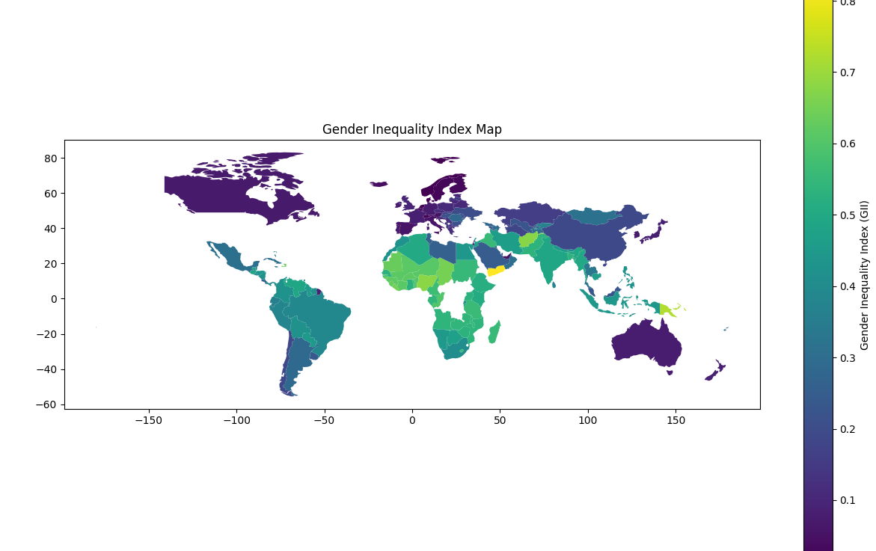
Gender inequality index map
This map provides a straightforward view of gender inequality across the world.
Darker colors indicate higher levels of inequality, while lighter shades represent areas with less disparity between genders.
It's a clear snapshot of the global landscape of gender equality efforts.

Slide 16
Next we are going to create more visual insights using powerBI by embedding report here.

Slide 17
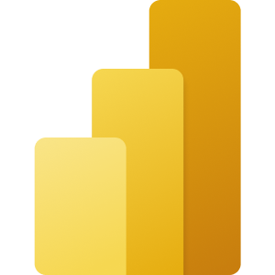
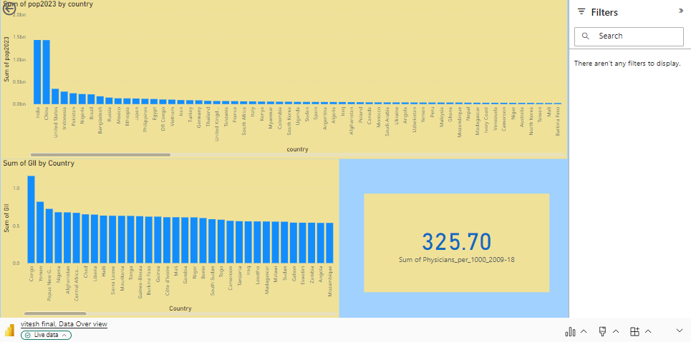
Microsoft Power BI

Slide 18
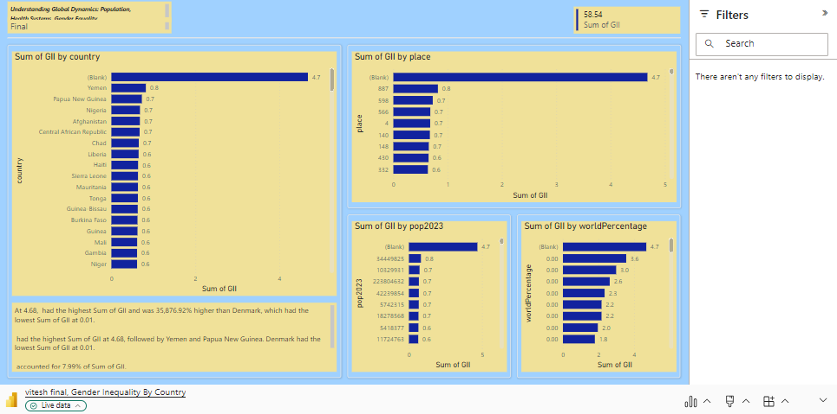
Microsoft Power BI

Slide 19
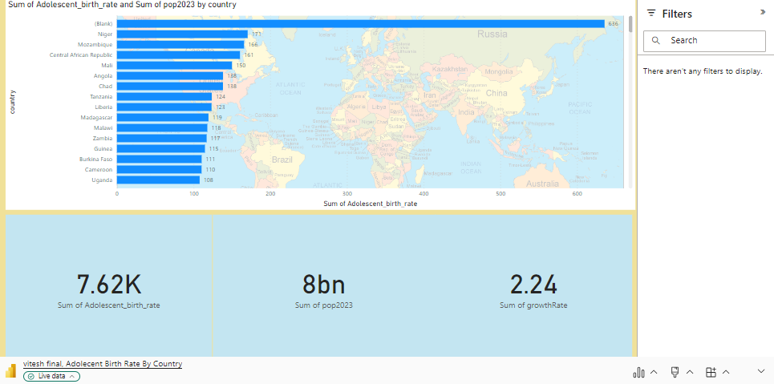
Microsoft Power BI

Slide 20
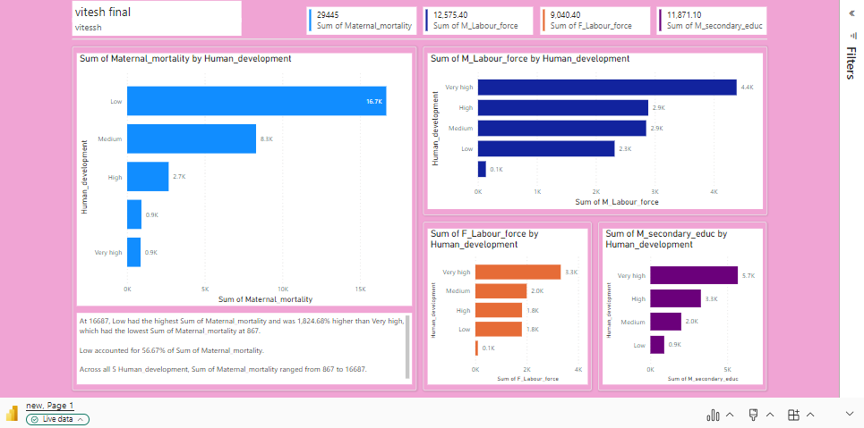
Microsoft Power BI

Slide 21
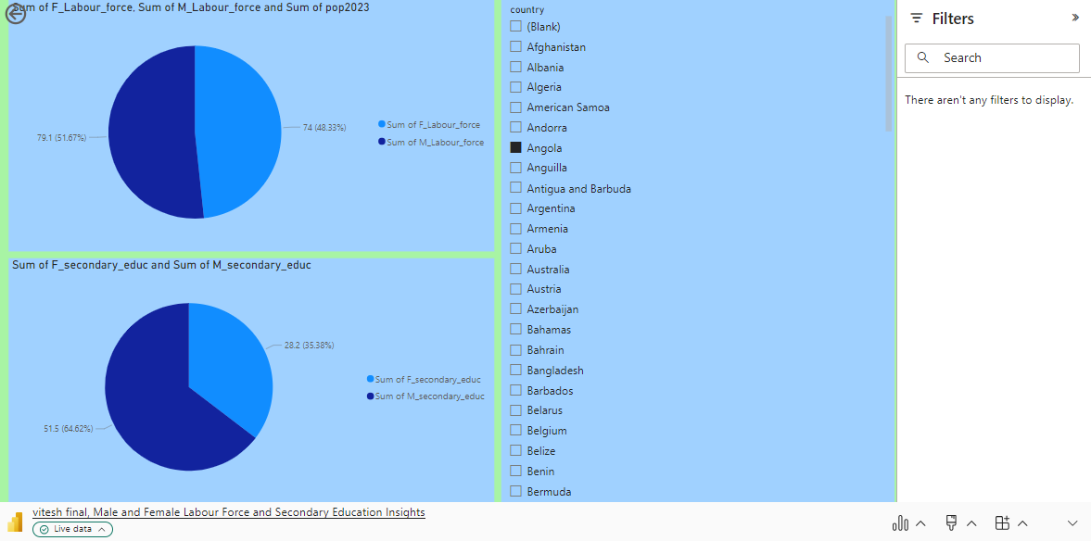

Slide 22
Work Management: Implementation Status Report
Work Completed:
Data Collection:
Description: Gathered relevant datasets from Kaggle.
Responsibility: All team members contributed to identifying and selecting datasets.
Contributions: Equal contribution from all team members.
Initial Visualization (D3.js):
Description: Created preliminary visualizations of the uncleaned dataset using D3.js.
Responsibility: Vitesh Chalicheemala
Contributions: Vitesh contributed 100% to this task.
Data Cleaning (Python):
Description: Cleaned the dataset using Python, Pandas, and NumPy.
Responsibility: Jaynica Nunna, Mounika Vankayalapati
Contributions: Jaynica and Mounika each contributed 50% to this task.
Refined Visualization (Python):
Description: Created refined visualizations based on the cleaned dataset using Python's data visualization libraries.
Responsibility: Supriya Ravilla
Contributions: Supriya contributed 100% to this task.

Slide 23
Work Management: Implementation Status Report
Dashboard Creation (Microsoft Power BI):
Description: Designed interactive dashboards and reports using Microsoft Power BI.
Responsibility: All team members collaborated on dashboard design and implementation.
Contributions: Equal contribution from all team members.
Report Generation:
Description: Created detailed reports summarizing analysis findings.
Responsibility: Jaynica Nunna
Contributions: Jaynica contributed 100% to this task.

Slide 24
Overall Contributions
Jaynica Nunna: 25%
Vitesh Chalicheemala: 25%
Mounika Vankayalapati: 25%
Supriya Ravilla: 25%

Slide 25
References
Kaggle. (n.d.). Kaggle: Your Home for Data Science. Retrieved from https://www.kaggle.com/
D3.js. (n.d.). D3.js - Data-Driven Documents. Retrieved from https://d3js.org/
Python Software Foundation. (n.d.). Python. Retrieved from https://www.python.org/
McKinney, W., Perktold, J., Seabold, S., & Wes McKinney. (2020). pandas-dev/pandas: Pandas 1.2.4. Zenodo. https://doi.org/10.5281/zenodo.4611042
Hunter, J. D. (2007). Matplotlib: A 2D Graphics Environment. Computing in Science & Engineering, 9(3), 90–95. https://doi.org/10.1109/MCSE.2007.55
Microsoft Corporation. (n.d.). Power BI. Retrieved from https://powerbi.microsoft.com/

